Slide 1


Bankruptcy Prediction
By – Yudhvir Mor(1191) and
Vineet Kapoor(11910076)
ISB CBA Practicum
8th February , 2019

Slide 2
Table Of Contents
Executive Summary
Business Problem
Introduction
Motivation For Study
Methodology & Tools
Models
Message
Means
Analytics Approach
Connecting CBA Term – 3 courses
Data collection & cleaning
Data Understanding
Data Preparation
Analysis & Results

Slide 3
Data Preparation
Data Understanding
Modelling & Evaluation
Business Recommendation
Assumptions, Limitations.
References.

Slide 4
Executive Summary
There exist a strong correlation between many ratios.
The Features are skewed and have many outliers.
ADASYN technique is applied to balance the classes and upsample the minority class.
Missing values are imputed by median imputation.
The features are scaled by log(1+x). The features are also normalized.
Test and Training set accuracies are almost 90%.
AUROC is 97% and F1 score is also 97%.

Slide 5
Methodology and Tools
Step 1
Step 2
Step 3
The data was cleaned and missing data is imputed. The data was imbalanced. So, minority samples were balanced using SMOTE and ADASYN techniques.
The Dataset was analysed using correlation heatmaps. And, the correlated features are removed form data. Business context was used to define the features.
Data was taken for only year 1 and year 3. Scaling of data is done and then , data is normalized.
Step 4
Step 5
Step 6
Training and Test sets accuracy are plotted for each classifier.
The training and validation data was created using sampling and K- fold cross validation. The whole modelling exercise is done on python using sklearn package.
Methods used for performing regression models are
ANN
KNN
Random Forest
Adaboost Classifier
GBM classifier
6. Optimization of Hyperparameters is also performed using Grid Search CV method.

Slide 6
Business Problem
Predicting the Bankruptcy rate of companies in 1 , 2, 3 , 4 , 5 years. There are 64 features and one target variable. To understand and analyse each of the 64 attributes along with 10,503 examples given and build a predictive model for bankruptcy rate of a given company.

Slide 7
Introduction
Bankruptcy of a firm is dependent on major 5 factors , they are
Working capital/ total assets., retained earnings/total assets, EBIT / total assets , book value of equity / total liabilities , sales / total assets.
The probability of company going bankrupt in 1 year and 3 years is predicted using all the features first, then only few features were used on the basis if their importance and collinearity with other features.
The external factors are also there which causes bankruptcy for a firm, they are global economic slowdown, consumer confidence might decline and that can lead to slow revenue.
Competitions from other firms can lead to cut in the revenue of small firms and can be a cause of bankruptcy.

Slide 8
Motivation For Study
Startup frequency
Bankrupt companies rate in india
Bankrupt companies rate in india
Bankrupt companies rate in india
Market conditions

Slide 9
Analytic Approach
The data was cleaned and missing data is imputed. The data was imbalanced. So, minority samples were balanced using SMOTE and ADASYN techniques.
The Dataset was analysed using correlation heatmaps. And, the correlated features are removed form data. Business context was used to define the features.
Data was taken for only year 1 and year 3. Scaling of data is done and then , data is normalized.
The training and validation data was created using sampling and K- fold cross validation. The whole modelling exercise is done on python using sklearn package.
Methods used for performing regression models are
ANN, KNN,Random Forest, Adaboost Classifier, GBM classifier,Optimization of Hyperparameters is also performed using Grid Search CV method.

Slide 10
Models
ANN- Artificial Neural Network using Keras.
GBM – Gradient Boosting Classifier model
KNN Classifier model
Bagging Classifier
SVM classifier
Decision trees
Random Forest model
Hyperparameter tuning using Grid Search CV method
K fold Cross validation model.

Slide 11
Means
Visualization Tools - Python
Modelling Tools – ANN, Random Forest, KNN, SVM, Decision Trees, GBM, Adaboost, Bagging classifier, Random forest packages from sklearn are used.
Packages used in Python: numpy, pandas, matplotlib, seaborn, StandardScaler, statsmodels.formula.api, Scipy, msno

Slide 12
Connecting CBA Term – 3 courses
ANN using Keras, Random Forest, GBM, AdaBoost, missing data imputation, KNN, Evaluation of Models using test and training sets accuracy and optimizing the Hyperparameters using Grid search method.
Statistics -3, DMG-2, Deep learning, Financial Analytics

Slide 13
Data collection & cleaning
The data was provided already.
Median imputation technique is used for missing data.
Preprocessing of data is done by balancing the data using SMOTE techniques. and normalizing using Log(1+x).
Feature engineering is done.

Slide 14
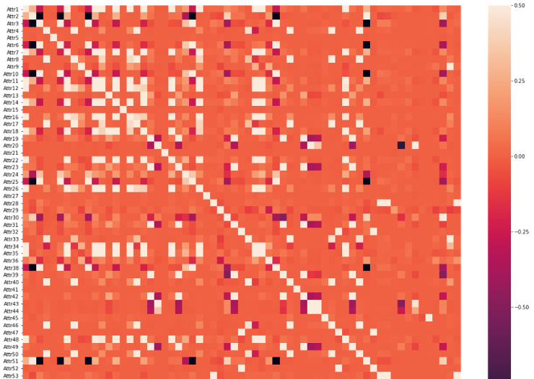
Data Analysis of features

Slide 15
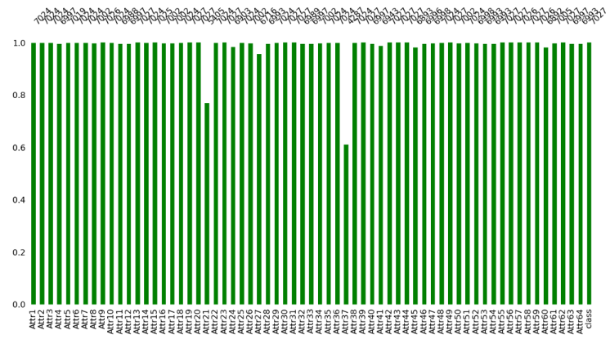

Slide 16
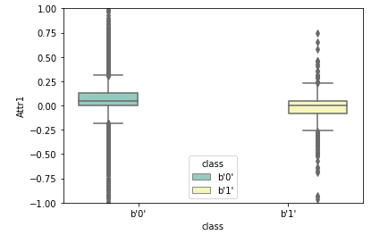
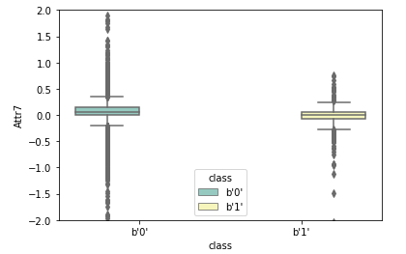
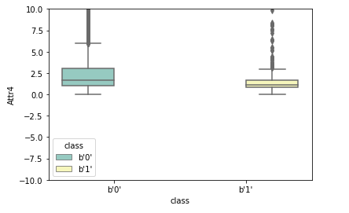
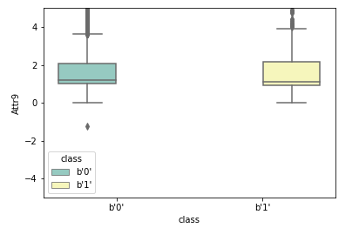
Backward Elimination Process

Slide 17
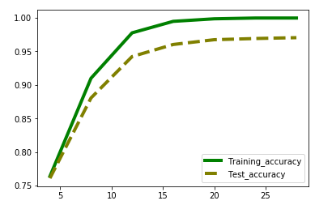
Final Model with constant term

Slide 18
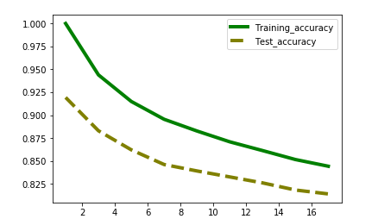

Slide 19
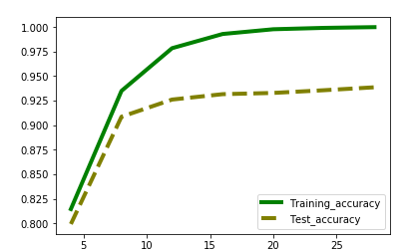
Regression Diagnostics

Slide 20
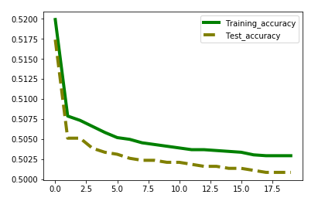
Influential Observations
Line plot of Predicted and Actual values

Slide 21
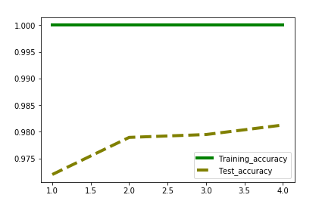
Scaling using min max scaler function is also performed and model is made using it.

Slide 22
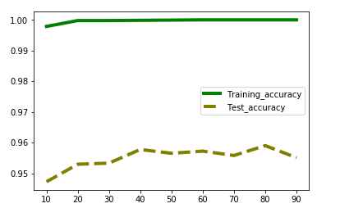

Slide 23
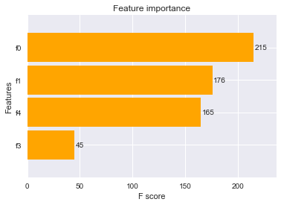
Features importance plot
Features importance plot using XG boost model. F- score has been compared for four features taken in this model.

Slide 24
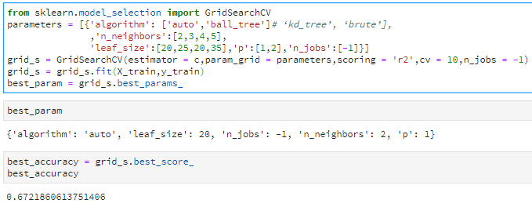
Grid search optimization method
Applying Grid search method #Optimization techniques. The method has been applied on KNN Regressor model. The parameters are chosen and are used for further analysis.

Slide 25
Modelling, evaluation
Root Mean Square error is used. Assumptions of Linear regression are tested for evaluation of model.
Models are evalueated using K – fold cross validation and residuals plot and optimized using Grid search method.

Slide 26
Business Recommendation
Forecasting model for medals can be made using Neural Network.
The OPTIMIZATION TECHNIQUES can be used for optimizing the model.
The data for more countries can be taken to make model more robust.

Slide 27
Assumptions, Limitations:
The data was collected for only 5 years from 2000 to 2016.
The data used for regression was small and the sample contains only 20 countries data.
Not able to collect data related to Sports centres, sports funding for countries.
The test data for year 2020 was not available for all fields. So, data for 2018 year is considered.
The features in dataset are not normal.
Assumptions of Multiple Regression are used in modelling

Slide 28
References
https://smallbusiness.chron.com/causes-business-bankruptcy-49407.html
http://www.shenehon.com/measuring-companys-risk-bankruptcy/
https://www.investopedia.com/articles/active-trading/081315/financial-ratios-spot-companies-headed-bankruptcy.asp

